Slide 1
2025-26 Swimming State Championships
Coaches Meeting
February 18, 2026

Slide 2
POE: Sportsmanship
Sportsmanship.
Good sporting behavior is one of the fundamental ingredients to the continued success and enjoyment of education-based high school sports and activities. Coaches set the tone at athletic contests with their display of sportsmanship. If these individuals act in a sportsmanlike manner, their behavior sets the tone for players, spectators and others.
In recent years, a heightened level of unsportsmanlike behavior has been occurring by spectators at high school sporting events, and it must be stopped. The use of demeaning language, or hate speech, by students, parents and other fans must cease. High school sports and other activities exist to lift people up, not demean or tear people down. The goal is to treat everyone fairly and treat each other with respect. Any speech or harassment that is insulting, demeaning or hurtful will not be tolerated.
High schools must establish a culture that values the worth of every single person – both players on the school’s team and players on the opposing team. There must be a no-tolerance policy regarding behavior that shows disrespect for another individual. Good sports win with humility, lose with grace and do both with dignity. It takes the efforts of everyone every day to ensure that sportsmanship remains one of the top priorities in education-based activity programs.
Notes:
Spectators- Specify the issues as well.
Most venues are not schools- the events are hosted in community/private facilities. Spectator laws in the state of Oregon may apply to the rented facility.

Slide 3
Tualatin Hills Aquatic Center
Parking: NO buses (including small buses) in the regular lot- Buses may drop off, then need to go down to the lot off of Blueridge Drive (North Lot). It is a lot beyond the soccer fields.
Entering the Facility: through the lobby and locker rooms
Exit the Facility: Through the doors on the dive platform side of the pool
Locker rooms
  Athletes are required to shower before entering the pool
  Non-participating athletes (athletes in street clothes) need to use the restrooms that are in the breezeway for the spectators
Participant Seating
  VERY tight on deck. Please be prepared to share space with another team.
  Alphabetical order, but please communicate with one another regarding team space needs.

Slide 4
Tualatin Hills Aquatic Center
On Deck
  NO FOOD
  Shared seating
  Spectators will be sitting on deck. Athletes will not be able to cheer in front of spectators or behind blocks.
  Coaches will be under the dive platforms

Slide 5
Coach Reminders
Jacki will review timing for turning in necessary information
Area available for coaches to go up to be off the deck but still able to see what is going on. Coaches’ hospitality is in the Northwest corner of the pool area.
Coach’s restroom is in the lobby, not in the locker room- THPRD follows Safe Sport requirements.
Medals- If your athlete/relay places first on Saturday, then you will be the person handing out the medals to the athletes. PLEASE be on time to the medal stand to hand them out.
Thank YOU for helping your athletes have the best experience possible!

Slide 6
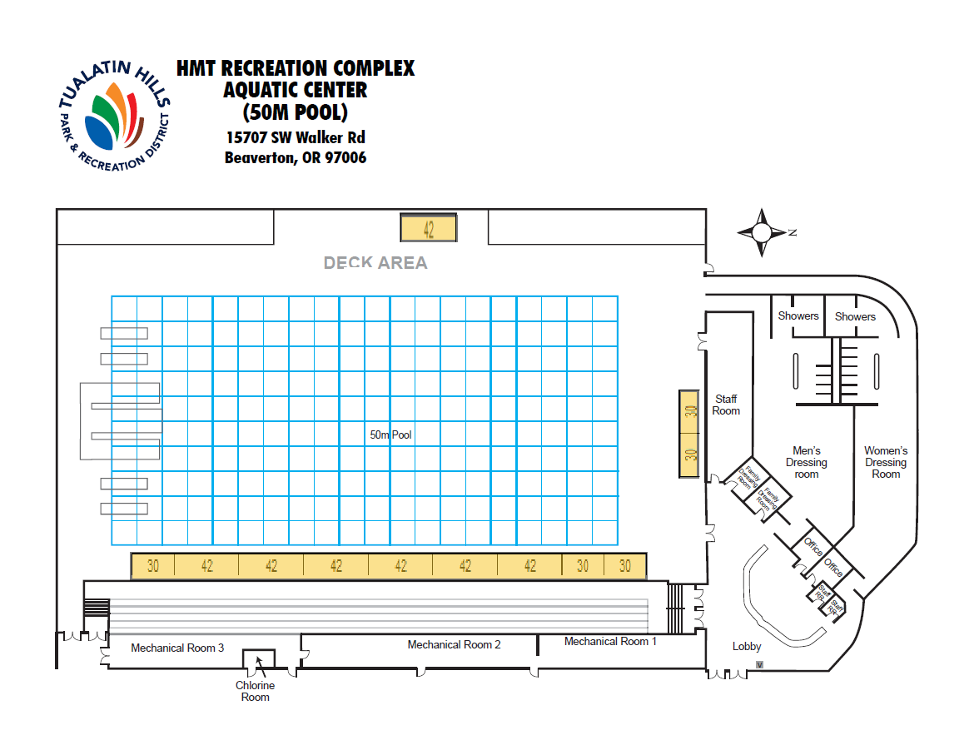

Slide 7
4A/3A/2A/1A | Tickets go on sale and doors open at 8:00am
Participants May Enter Facility | 7:15am
Competition Tank Warm-Up | 7:30am – 8:45am
Officials Meeting | 7:45am
Clear Pool | 8:45am
Preliminaries | 9am – 11:15am
Clear Building | 11:30am
5A | Tickets go on sale and doors open at 12:45pm
Participants May Enter Facility | Noon
Competition Tank Warm-Up | 12:15pm – 1:30pm
Officials Meeting | 12:30pm
Clear Pool | 1:30pm
Preliminaries | 1:45pm – 4pm
Clear Building | 4:15pm
6A | Tickets go on sale and doors open at 5:30pm
Participants May Enter Facility | 4:45pm
Competition Tank Warm-Up | 5pm – 6:15pm
Officials Meeting | 5:15pm
Clear Pool | 6:15pm
Preliminaries | 6:30pm – 8:45pm
Clear Building | 9pm
4A/3A/2A/1A | Tickets go on sale and doors open at 7:15am
Participants May Enter Facility | 6:45am
Competition Tank Warm-Up | 7am – 8am
Officials Meeting | 7:15am
Clear Pool | 8am
Parade of Officials | 8:10am
Championship Finals (All Para-Athlete Finals) | 8:15am – 11:15am
Clear Building | 11:30am
5A | Tickets go on sale and doors open at 12:15pm
Participants May Enter Facility | 11:45am
Competition Tank Warm-Up | Noon – 1pm
Officials Meeting | 12:15pm
Clear Pool | 1pm
Parade of Officials | 1:10pm
Championship Finals | 1:15pm – 4:15pm
Clear Building | 4:30pm
5A | Tickets go on sale and doors open at 5:30pm
Participants May Enter Facility | 5:00pm
Competition Tank Warm-Up | 5:15pm – 6:15pm
Officials Meeting | 5:30pm
Clear Pool | 6:15pm
Parade of Officials | 6:25pm
Championship Finals | 6:30pm – 9:30pm
Clear Building | 9:45pm

Slide 8
Para-Athlete Reminders
Para-Athlete Finals: During the 4A/3A/2A/1A Finals for ALL para-athletes and all para-athlete events

Slide 9
Volunteers - Needed
The link to sign-up: https://www.signupgenius.com/go/10C0E4CA8AA23A6F9CF8-62409905-osaa#/
Positions needed
  Safety Marshall
  Runner
  Head Timer
  Lane Timers
25% of the positions are filled up (both days), thanks for getting this out to your community!
We need your help to run this meet!!!

Slide 10
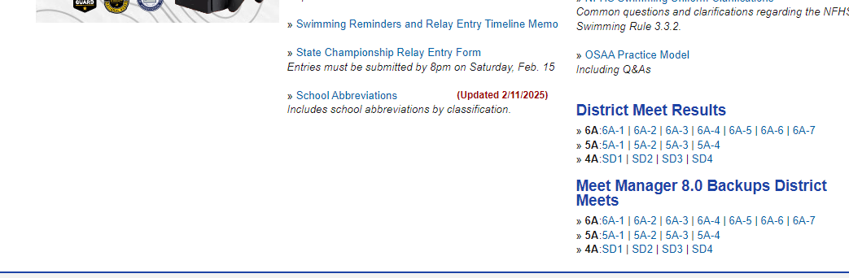
Meet Manager 8.0 Backups – District Meets
The files are posted on the website https://www.osaa.org/activities/bsw

Slide 11
OSAA Swimming State Rules Interpreter
Jacki Allender

Slide 12
RELAY ENTRY TIMELINE
  Schools shall submit up to eight names for relays with their entry.
  A RELAY SLIP with the names of the four athletes to compete or a NO CHANGE slip may be submitted if the swimmers will compete in the listed order. DO NOT SUBMIT BOTH.
  Entries shall be submitted to the designated meet personnel for each relay no later than the following deadlines:
    Medley Relay – 45 minutes prior to the start of competition
    200 Free Relay – at the start of the girls 100 Butterfly
    400 Free Relay – at the start of the boys 500 Freestyle
  There shall be no changes in the four athletes once the deadline has passed (order may be changed) except as permitted in NFHS Rule 3.2.2 (...illness or injury certified by a physician or the referee forces a competitor to withdraw).
  The first swimmer of a relay team, once called to the starting platform by the referee, shall not change his/her swimming order in the relay event with any teammate (NFHS Rule 8.3.4).

Slide 13
Number of Entries Allowed Per Individual
2025-26 NFHS Swimming Rules Book, Rule 3.2.1 – “A competitor shall be permitted to enter a maximum of four events, no more than two of which may be individual events. Prelims and finals are considered one meet .”
**Remember prelims and finals are one event.

Slide 14
State Championship Meet Referees
4A/3A/2A/1A – Jack Burnett
5A – Judi Creech
6A – Julie Carpenter

Slide 15
Question and Answers Time
Are there any specific questions coaches have?

Slide 16
2026 Swimming State Championships Coaches Meeting
THANK YOU for what you DO!!!
Good-luck to everyone, we are looking forward to a tremendous event!

Slide 17
Questions
Contact Kris Welch with any question
krisw@osaa.org 503-682-6722 ext. 230
HY-Tek questions: Pat Allender
patrick.allender@gmail.com
Rules Questions: Jacki Allender
swimming.sri@osaa.org

